Slide 1

Introduction
Optical Wireless Networks: Free Space Optics (FSO) represents a transformative, laser-based communication paradigm that delivers fiber-like capacity through the atmosphere, specifically designed for regions where physical infrastructure is unfeasible.
The Optical Advantage over Radio & Microwave: While traditional RF and Microwave links struggle with spectrum congestion and electromagnetic interference, FSO take advantages of the vast, license-free optical band to provide secure, gigabit-scale bandwidth with inherent resistance to jamming.
Advancing Beyond Conventional Optical Links: This research moves past the limitations of standard FSO by implementing spectrally efficient Quadrature Amplitude Modulation (QAM) on FPGA hardware, drastically increasing data throughput over traditional On-Off Keying (OOK) methods.
Intelligence for Weather Resilience: To address the inherent instability of optical signals during rain or fog, the system integrates Deep Neural Networks (DNNs) to provide instantaneous performance forecasting, replacing slow theoretical models with real-time predictive intelligence.
Mission-Driven Infrastructure for Jharkhand: By synthesizing high-speed hardware with AI-driven analysis, this project establishes a scalable, low-latency backhaul engineered to support the telemedicine, e-learning, and e-governance needs of Jharkhand’s underserved rural and tribal communities.

Slide 2
Motivations: Why FSO for Jharkhand?
Topographical Barriers: Rocky terrain in the Chota Nagpur plateau makes traditional fiber trenching prohibitively expensive and technically impractical.
Environmental Constraints: Protected zones (e.g., Saranda, Palamau) have strict Right-of-Way (RoW) rules. FSO bridges these forests wirelessly without ground disruption.
The "Last-Mile" Bridge: Delivers high-speed backhaul to remote districts like Latehar, Simdega, and Gumla where laying fiber is highly challenging..
Weather-Resilient Connectivity: Conventional wireless often fails during heavy monsoons and winter fog; this system is engineered for Jharkhand's specific adverse weather.
Infrastructure Security: Unlike physical cables, which are prone to theft and accidental damage in remote regions, FSO links are air-bound and immune to tampering.
Socio-Economic Impact: Enables telemedicine for rural clinics, virtual classrooms for plateau schools (e.g., Netarhat), and digital governance for tribal communities.
Industrial Efficiency: Provides direct, high-speed intranet for remote mining hubs (e.g., Kiriburu) across valleys without 20KM+ cable detours.

Slide 3
Objectives
Sl. No. | Objectives
1. | Development of an end-to-end FSO transmitter-receiver pair to provide high-speed connectivity to rural terrestrial users.
2. | Development of firmware to implement higher-order QAM techniques for achieving enhanced data rates.
3. | Design of a testbed to simulate various weather conditions and collect experimental data.
4. | Analysis of the impact of adverse weather conditions (fog and rain) on the performance of FSO systems.
5. | Modelling of small-scale fading coefficients using the collected experimental data.
6. | Derivation of performance metrics to obtain design parameters for the FSO system, validated through Monte Carlo simulations.

Slide 4


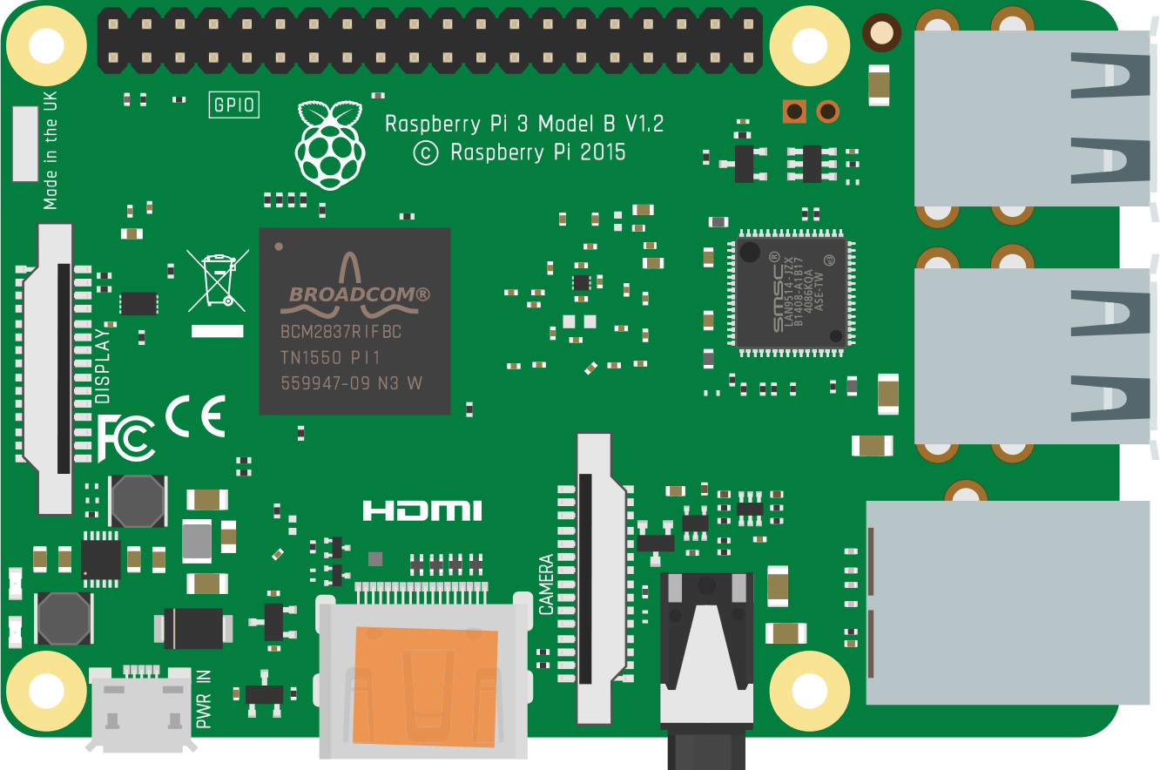





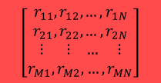
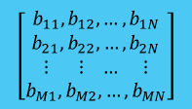
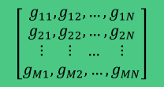

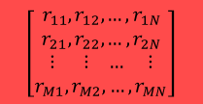
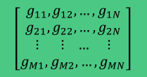
Proposed Model: Training
$$\left[\begin{aligned}r_{11}, r_{12},…, r_{1N} \\ r_{21}, r_{22},…, r_{2N} \\ ⋮ ⋮ … ⋮ \\ r_{M1}, r_{M2},…, r_{MN}\end{aligned}\right]$$
$$\left[\begin{aligned}g_{11}, g_{12},…, g_{1N} \\ g_{21}, g_{22},…, g_{2N} \\ ⋮ ⋮ … ⋮ \\ g_{M1}, g_{M2},…, g_{MN}\end{aligned}\right]$$
$$\left[\begin{aligned}b_{11}, b_{12},…, b_{1N} \\ b_{21}, b_{22},…, b_{2N} \\ ⋮ ⋮ … ⋮ \\ b_{M1}, b_{M2},…, b_{MN}\end{aligned}\right]$$
$$\left[\begin{aligned}r_{11}, r_{12},…, r_{1N} \\ r_{21}, r_{22},…, r_{2N} \\ ⋮ ⋮ … ⋮ \\ r_{M1}, r_{M2},…, r_{MN}\end{aligned}\right]$$
Source
FPGA
$$\left[\begin{aligned}g_{11}, g_{12},…, g_{1N} \\ g_{21}, g_{22},…, g_{2N} \\ ⋮ ⋮ … ⋮ \\ g_{M1}, g_{M2},…, g_{MN}\end{aligned}\right]$$
$$\left[\begin{aligned}b_{11}, b_{12},…, b_{1N} \\ b_{21}, b_{22},…, b_{2N} \\ ⋮ ⋮ … ⋮ \\ b_{M1}, b_{M2},…, b_{MN}\end{aligned}\right]$$
Air Intake
Receiver
Decoded RGB Matrices
QAM Demodulator
Encoded RGB Matrices
Moisture Absorber
Testbench Controller
DL Prediction of Control Parameters
Signal Conditioning
Air Outlet
FPGA
Influence of Direct Sunlight
Sensors
QAM Modulator
Heater
Influence of Ambience Light
Compressor
Warm Air
Air Outlet
LASER Driver
Inlet and Outlet Pumps
Heat and Airflow Control Stage
Influence of Direct Sunlight
Influence of Rain/Drizzle, Fog, and Daylight
LASER Detector

Slide 5
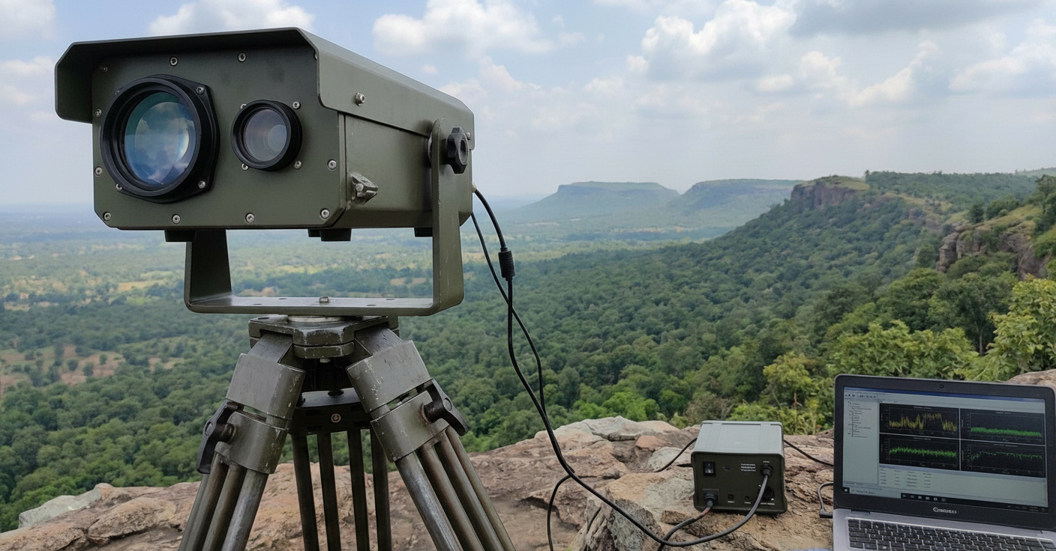
Proposed Model: To be deployed
DL based QAM MODEM
DL based QAM MODEM
Source
Receiver
LASER Driver
and Signal Conditioning
LASER Driver
and Signal Conditioning
Full Duplex FSO Link

Slide 6
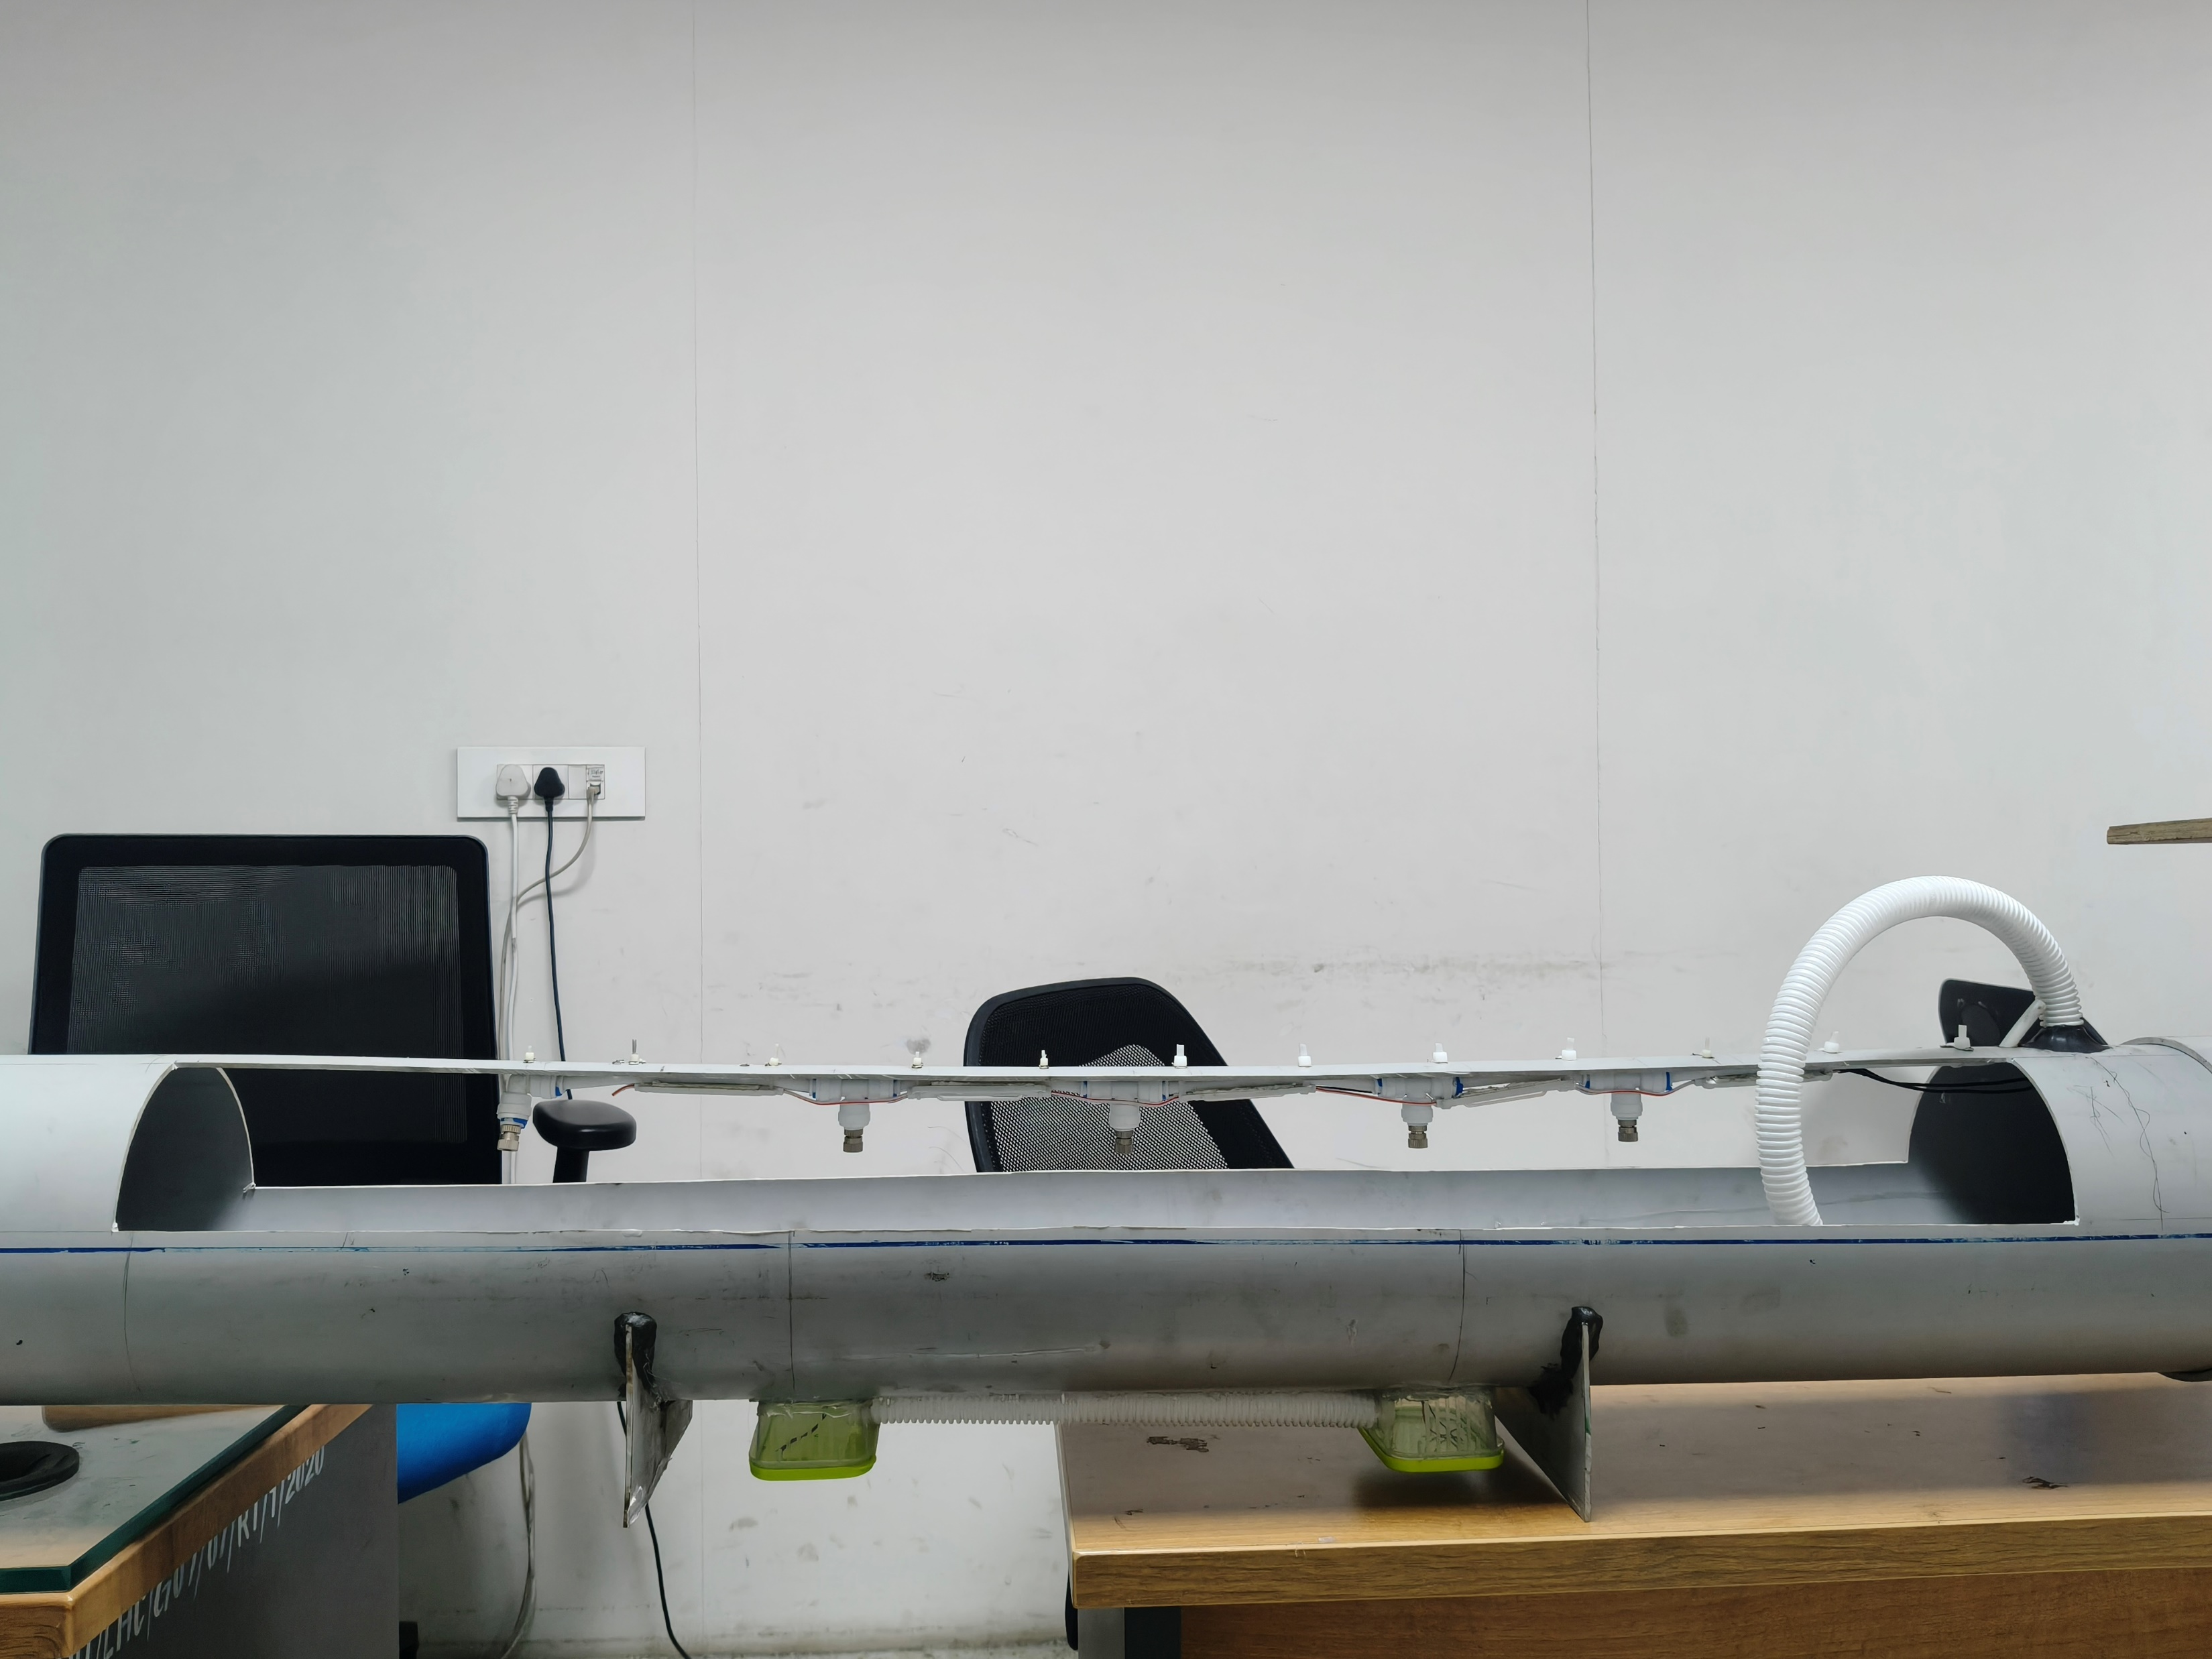
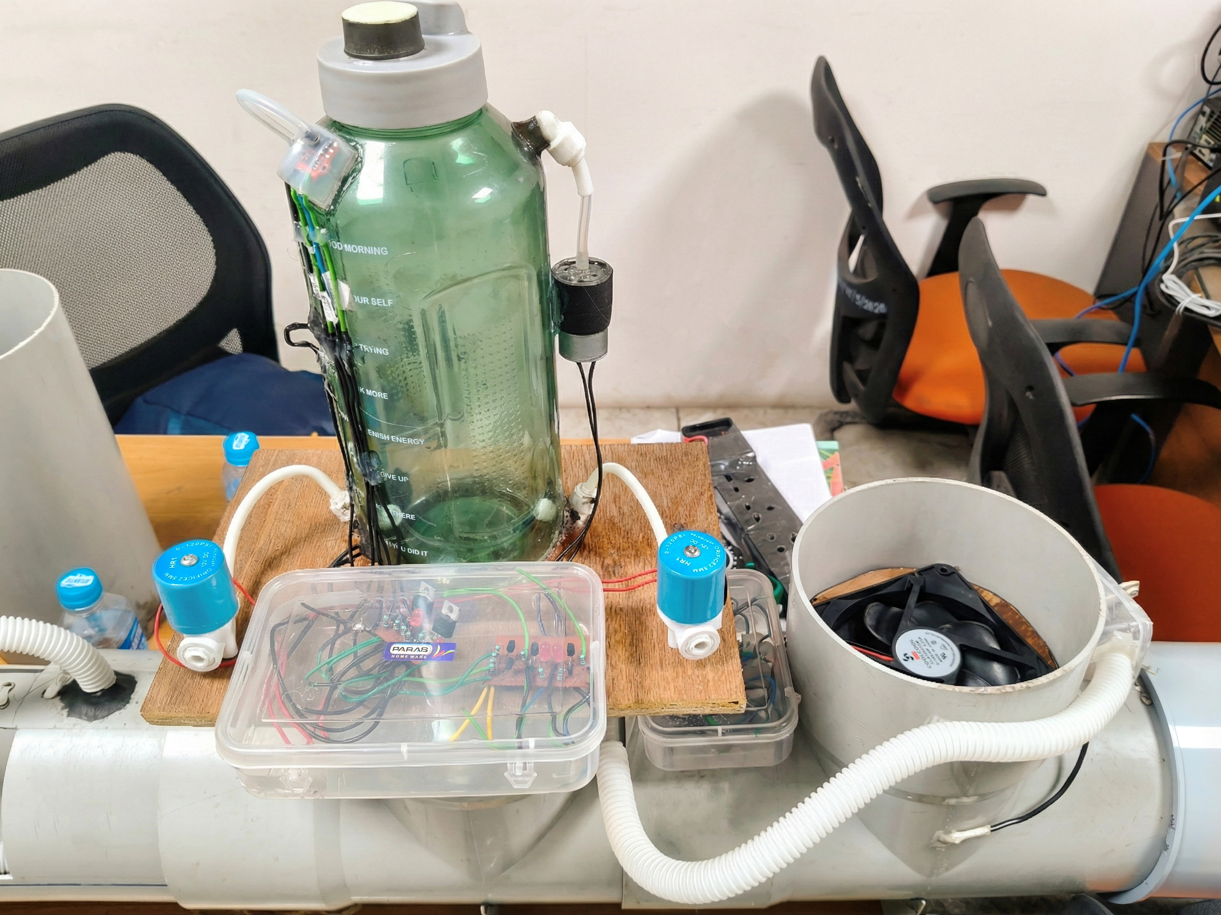
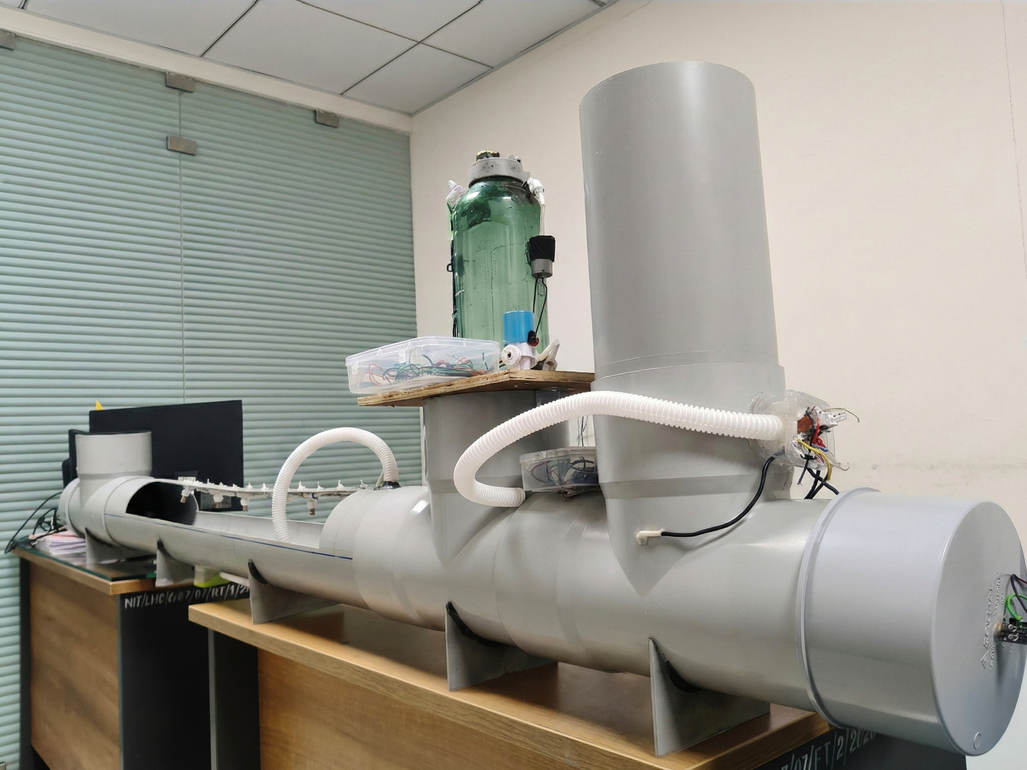
Proposed Model: Progress till now
Fig 1: Rain, Drizzle, Fog Control Unit
Fig 2: Interconnection of all units
Fig 3: Compressor, Airflow, Temperature Control Unit

Slide 7
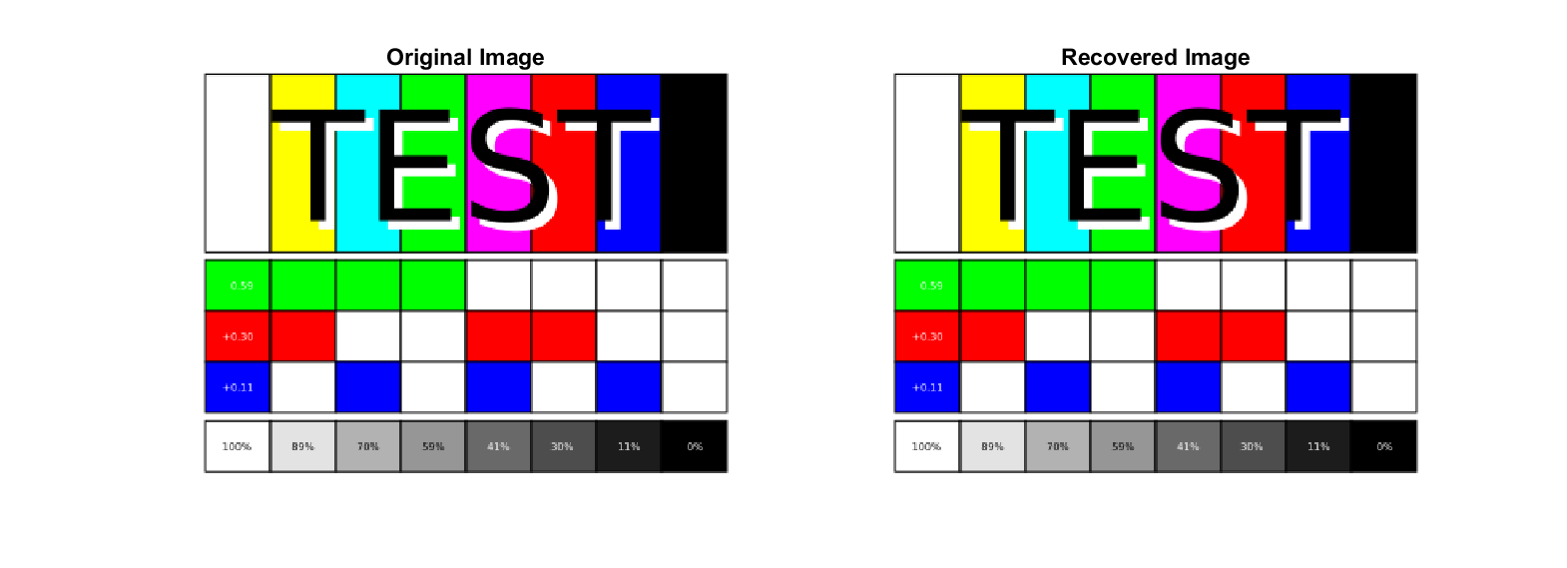
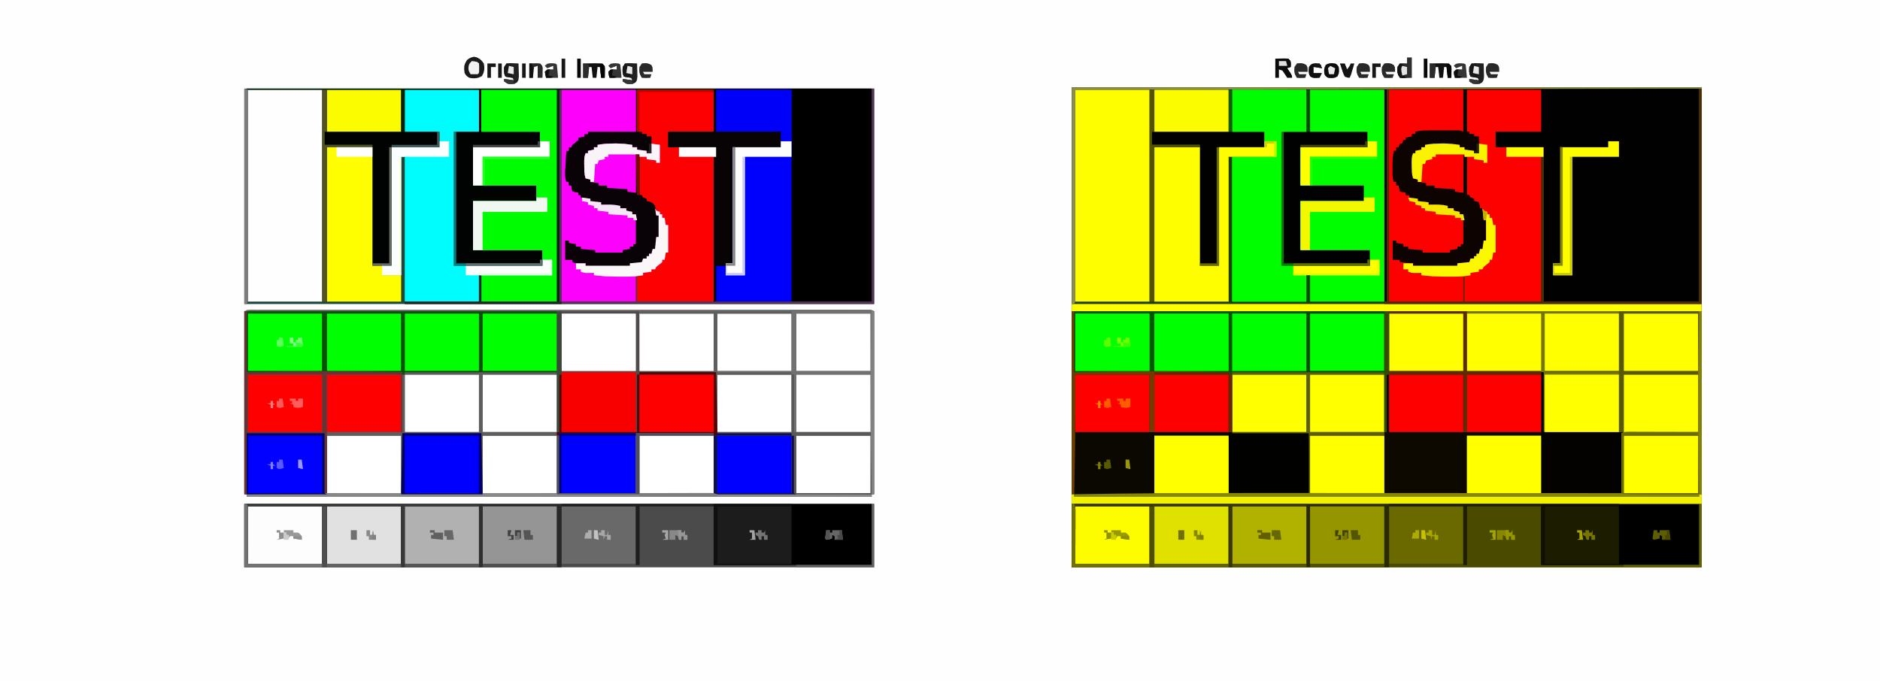
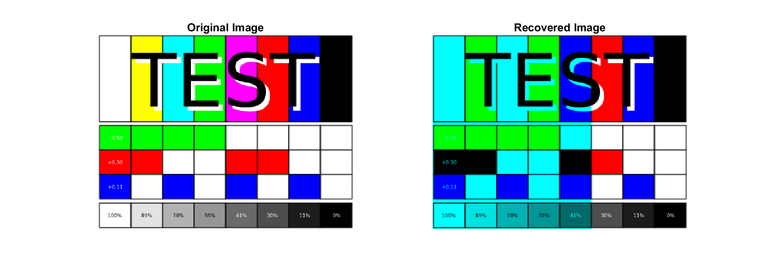
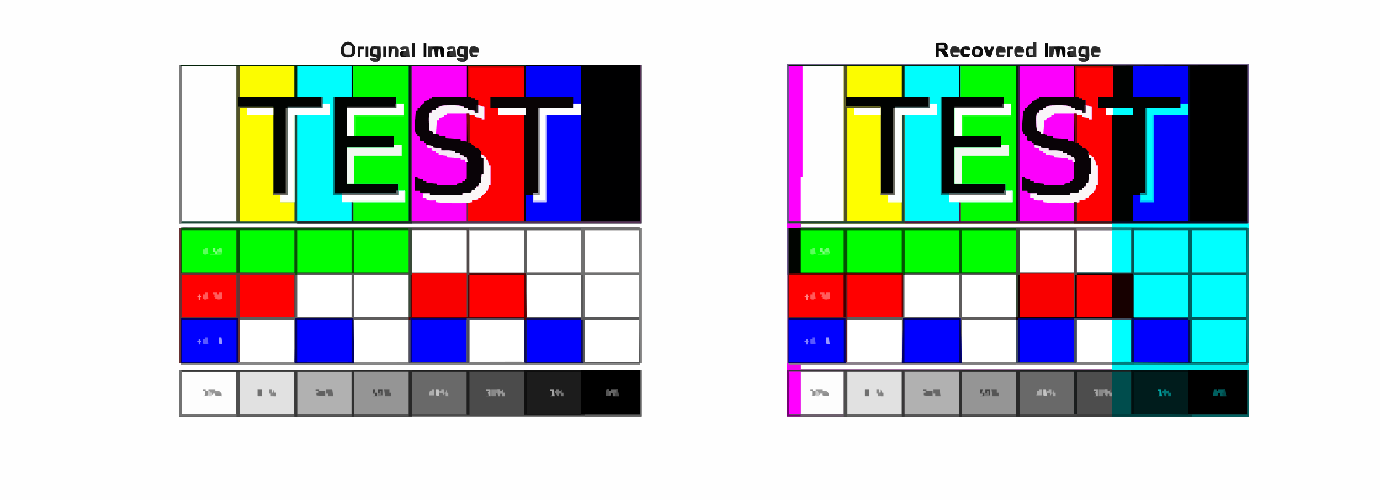
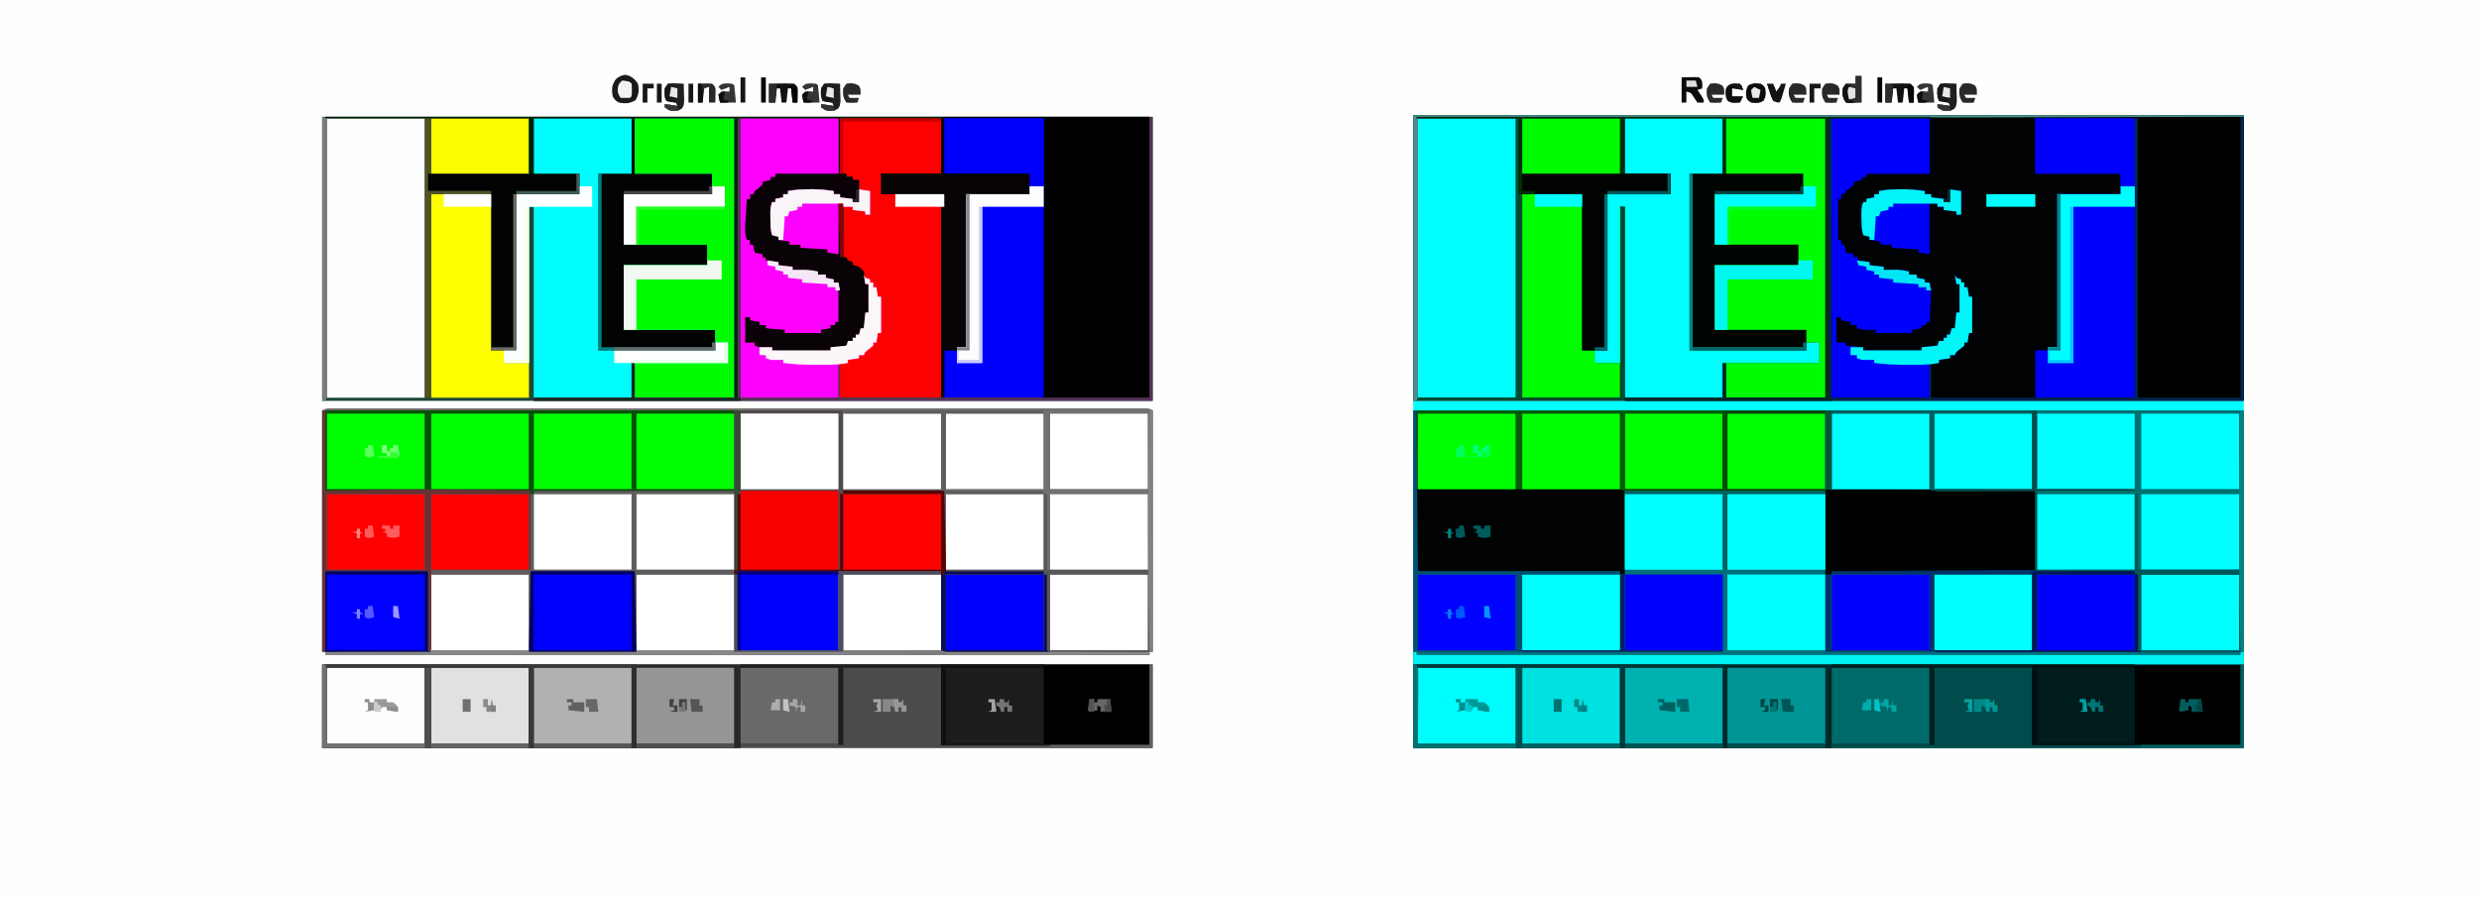
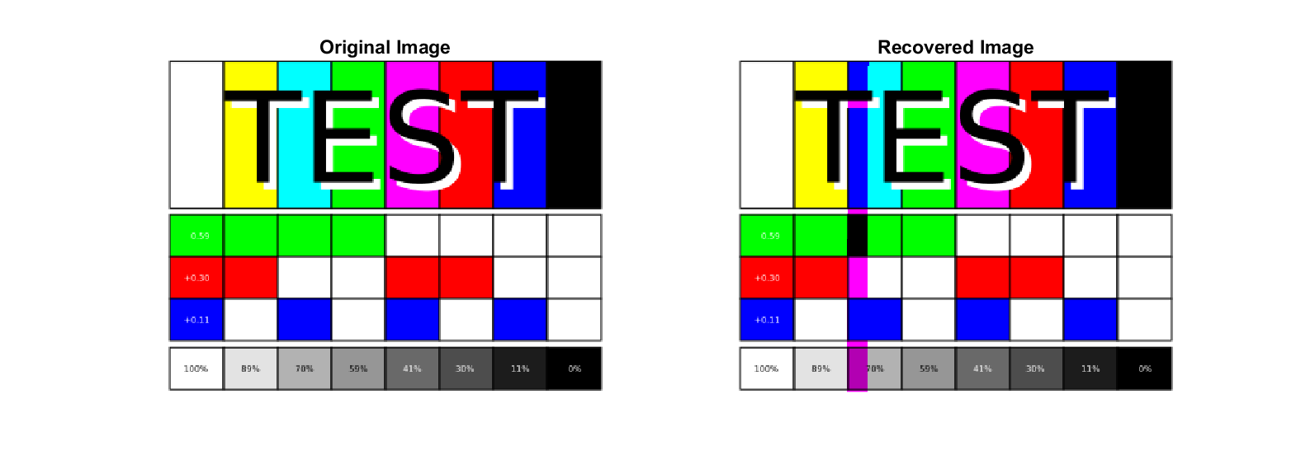
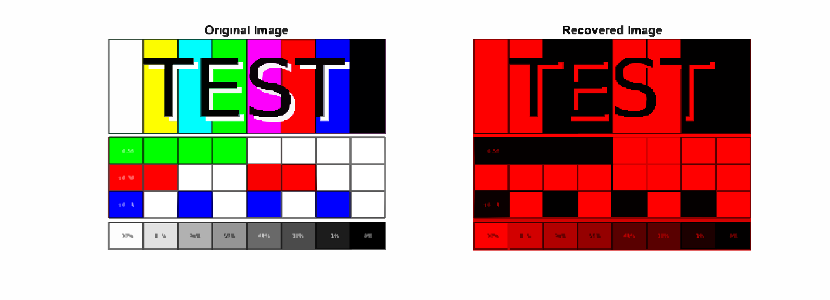
Serial Data Synchronization: Progress till now
Fig 4: Reference Image
Fig 5: Correctly Received Image
Fig 6: Completely Corrupted Blue Channel
Fig 7: Partially Corrupted Red Channel
Fig 8: Partially Corrupted Green and Red Channel
Fig 9: Completely Corrupted Red Channel
Fig 10: Partially Corrupted Green Channel
Fig 11: Completely Corrupted Blue and Green Channel

Slide 8
Methodology
1. System Design Phase
a. FPGA-based FSO Transmitter-Receiver Design
b. QAM Firmware Development
2. Testbed Development Phase
a. Controlled Environment for Fog, Rain, Drizzle Simulation
3. Experimental Phase
a. Data Collection under Various Weather Conditions
4. Modelling Phase
a. Small-Scale Fading Modelling (MATLAB)
5. Performance Analysis
a. Derivation of Performance Metrics
b. Monte Carlo Simulations
7. Validation Phase
a. Experimental Validation of System Reliability
8. Prototyping
6. DNN-Assisted Prediction
a. Training of DNN Models using Derived Metrices
b. Validation of Prediction Accuracy

Slide 9
Expected Outcomes of the Proposal
FPGA-Based QAM-FSO Hardware Prototype
Adverse Weather Simulation Testbed
Experimental Performance Validation
Small-Scale Fading Characterization
Monte Carlo–Verified Analytical Models
DNN-Based Intelligent Performance Prediction
Reduced Computational Complexity
Reusable and Modular FPGA Firmware
Field-Deployable Rural Broadband Framework
Research Assets and Skilled Manpower Development

